Slide 1

PROJECT ON
HOUSING PRICE PREDICTION
Submitted By
Nimesh Roy

Slide 2

Brief About Project
Houses are one of the necessary need of each and every person around the globe and therefore housing and real estate market is one of the markets which is one of the major contributors in the world’s economy. It is a very large market and there are various companies working in the domain. Data science comes as a very important tool to solve problems
in the domain to help the companies increase their overall revenue, profits, improving their marketing strategies and focusing on changing trends in house sales and purchases.
Predictive modelling, Market mix modelling, recommendation systems are some of the machine learning techniques used for achieving the business goals for housing
companies. Our problem is related to one such housing company.

Slide 3
Problem Statement
A US-based housing company named Surprise Housing has decided to enter the Australian market. The company uses data analytics to purchase houses at a price below their actual values and flip them at a higher price.
For the same purpose, the company has collected a data set from the sale of houses in Australia.
The company is looking at prospective properties to buy houses to enter the market. You are required to build a model using Machine Learning in order to predict the actual value of the prospective properties and decide whether to invest
in them or not.
For this company wants to know:
• Which variables are important to predict the price of variable?
• How do these variables describe the price of the house?

Slide 4
DATA BRIEFING

Slide 5

The data has two sets (test.csv, train.csv). Model have to train on train.csv dataset and predict on test.csv dataset.
Train data contains 1168 entries each having 81 variables.
Test data contains 292 entries each having 80 variables.
Train data have 4460 null values.
Test data have 1407 null values.
Both Data set have no duplicate values.
Both Data sets are of “Object ” type.
Train data --- dtypes: float64(3), int64(35), object(43)
memory usage: 739.2+ KB
Test data --- dtypes: float64(4), int64(34), object(42)
memory usage: 182.6+ KB

Slide 6
Exploratery Data Analysis

Slide 7
Numerical Features Count 38
Discrete feature Count 18
Continuous feature Count 20
Categorical feature Count 43
Train Data
Test Data
Numerical Features Count 38
Discrete feature Count 20
Continuous feature Count 18
Categorical feature Count 42

Slide 8
KitchenAbvGr -0.132108
EnclosedPorch -0.115004
OverallCond -0.065642
MSSubClass -0.060775
YrSold -0.045508
LowQualFinSF -0.032381
Id -0.023897
MiscVal -0.013071
BsmtHalfBath -0.011109
BsmtFinSF2 -0.010151
WoodDeckSF 0.315444
2ndFlrSF 0.330386
OpenPorchSF 0.339500
LotFrontage 0.341294
BsmtFinSF1 0.362874
Fireplaces 0.459611
MasVnrArea 0.466386
GarageYrBlt 0.474346
3SsnPorch 0.060119
MoSold 0.072764
ScreenPorch 0.100284
PoolArea 0.103280
BedroomAbvGr 0.158281
BsmtFullBath 0.212924
BsmtUnfSF 0.215724
LotArea 0.249499
HalfBath 0.295592
Negative Correlation
Less Correlation
Less Correlation
Correlation with Target Variable
Strong Correlation
YearRemodAd 0.507831
YearBuilt 0.514408
TotRmsAbvGrd 0.528363
FullBath 0.554988
1stFlrSF 0.587642
TotalBsmtSF 0.595042
GarageArea 0.619000
GarageCars 0.628329
GrLivArea 0.707300
OverallQual 0.789185
SalePrice 1.000000

Slide 9
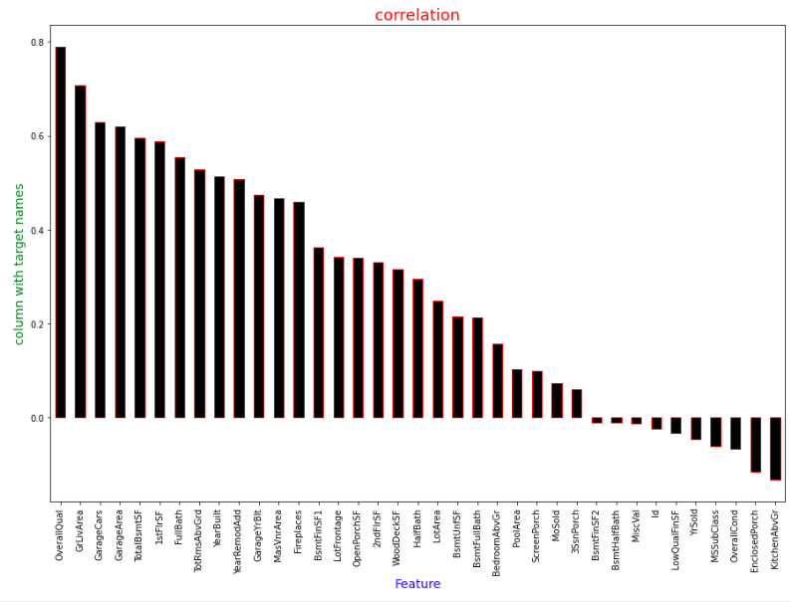

Slide 10
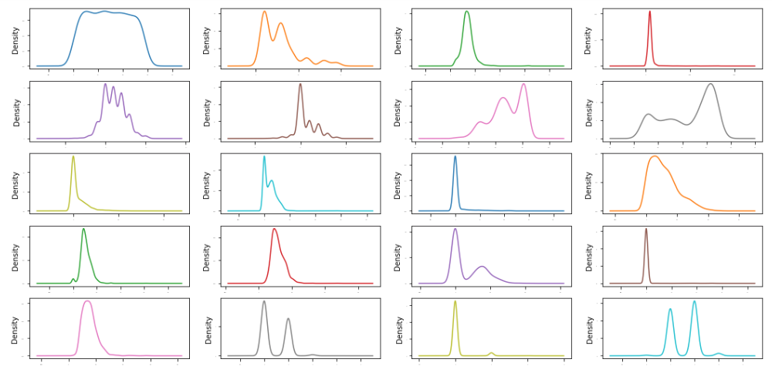
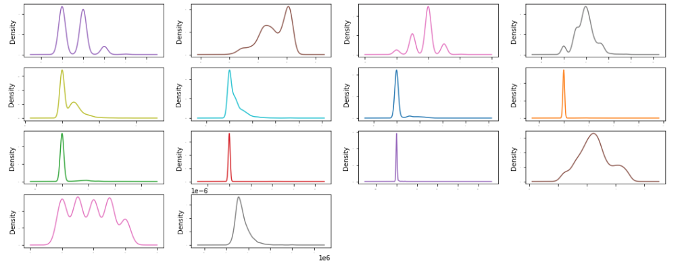
We have seen heavy skewness in some variables.
MiscVal 23.065943 PoolArea 13.243711
LotArea 10.659285 3SsnPorch 9.770611
LowQualFinSF 8.666142

Slide 11
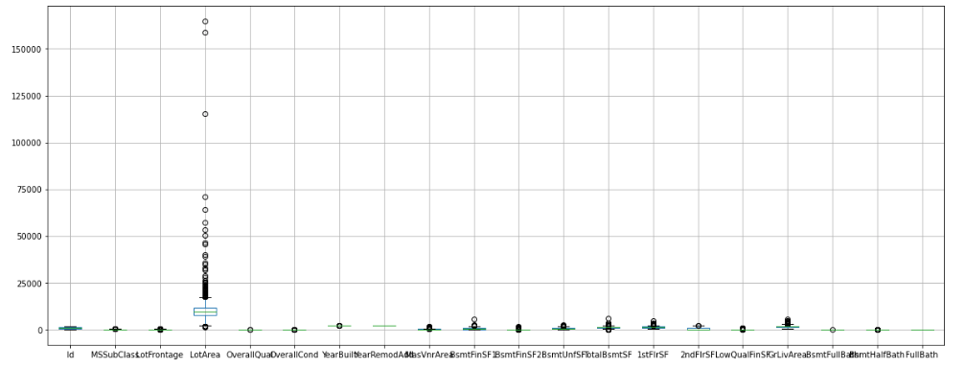
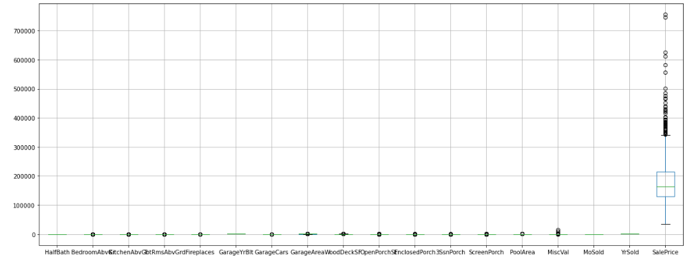

Slide 12
Null Value Imputation on Neumeric Variables
LotFrontage 214
LotFrontage 0
MasVnrArea 7
Random Sample Imputation
MasVnrArea 0
GarageYrBlt 64
GarageYrBlt 0

Slide 13
Null Value Imputation on Categoric Variables
Alley 1091
MasVnrType 7
BsmtQual 30
BsmtCond 30
BsmtExposure 31
BsmtFinType1 30
BsmtFinType2 31
FireplaceQu 551
GarageType 64
GarageFinish 64
GarageQual 64
GarageCond 64
PoolQC 1161
Fence 931
MiscFeature 1124
fillna( ) method
Alley 0
MasVnrType 0
BsmtQual 0
BsmtCond 0
BsmtExposure 0
BsmtFinType1 0
BsmtFinType2 0
FireplaceQu 0
GarageType 0
GarageFinish 0
GarageQual 0
GarageCond 0
PoolQC 0
Fence 0
MiscFeature 0

Slide 14
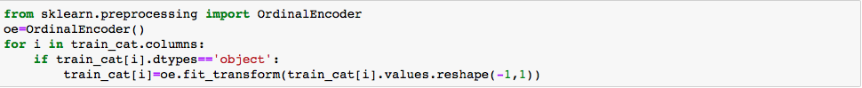
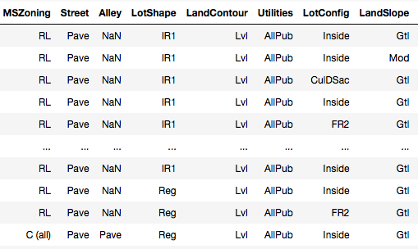
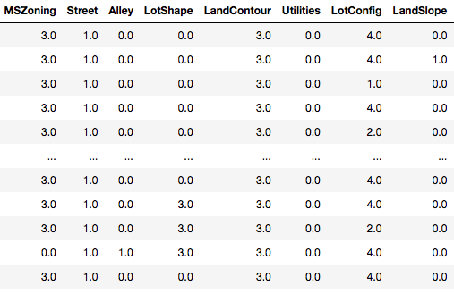
Convert String Values into Neumeric Values
Ordinal
Encoder

Slide 15
So we performed these steps in data preprocessing :-
null values in neumerical features
Null Value Imputation
null values in categorical features
negative correlation
Correlation with target variable
zero correlation
positive correlation
Checking Outliers
Encode the Cegorical Data
convert strings into neumeric values
left skewed
Data Distributon
normal
right skewed
Scaling the Data
bring the data into specific range

Slide 16
Data Splitting and Model Selection

Slide 17
Splitting the data
80 % train data
Data
MODEL
20 % test data
PREDICTIONS

Slide 18

Scale the Data
Data Range Before Scalling
Data Range After Scalling

Slide 19
Principal Component Analysis
PCA is an unsupervised statistical technique that is used to reduce the dimensions of the dataset
The Dimension of data is
1168 rows × 81 columns before PCA
The Dimension of data is
1168 rows × 47 columns after PCA

Slide 20
MODELS WE USED
Because it is a regression base problem ,we use regressor algorithms.
Linear Regression.
Decision Tree Regressor.
Random Forest Regressor.
KNeighbor Regressor.
XGBoost Regressor

Slide 21
Model's Performances
MODEL NAME | ACCURACY SCORE | CV SCORE
Linear Regression | 76.45647914163176 | 78.17395054506335
KNN Regressor | 0.7668626110862068
Decision Tree Regressor | 0.7447404685606169 | 62.328909662879674
Random Forest Regressor | 71.39893543047012 | 75.90491249318563
Randomized Search CV | 0.9536002035642823 | 75.90491249318563
XGBoost Regressor | 0.999996892365239 | 0.7831118690758827

Slide 22
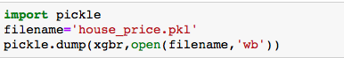
Finalizing Model
So based on the accuracy score and cross validation score , we can say the XGBoost Algorithm based model is working well on data .
So we decide to finalize the XGBoost based model.

Slide 23
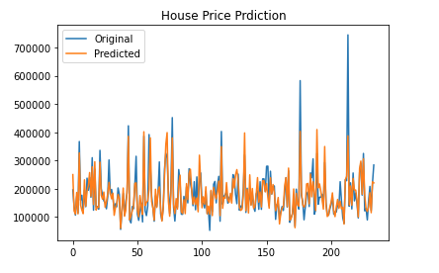
conclusion

Slide 24

THANK YOU

